Slide 1

Stories and Scenarios
Scenarios are real-life examples of how a system can be used.
They should include
A description of the starting situation;
A description of the normal flow of events;
A description of what can go wrong;
Information about other concurrent activities;
A description of the state when the scenario finishes.

Slide 2
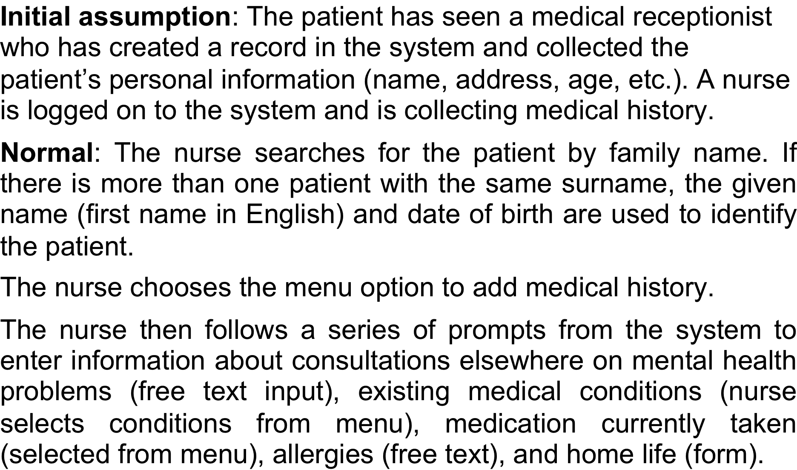
Scenario for collecting medical history in MHC-PMS
Chapter 4 Requirements engineering

Slide 3
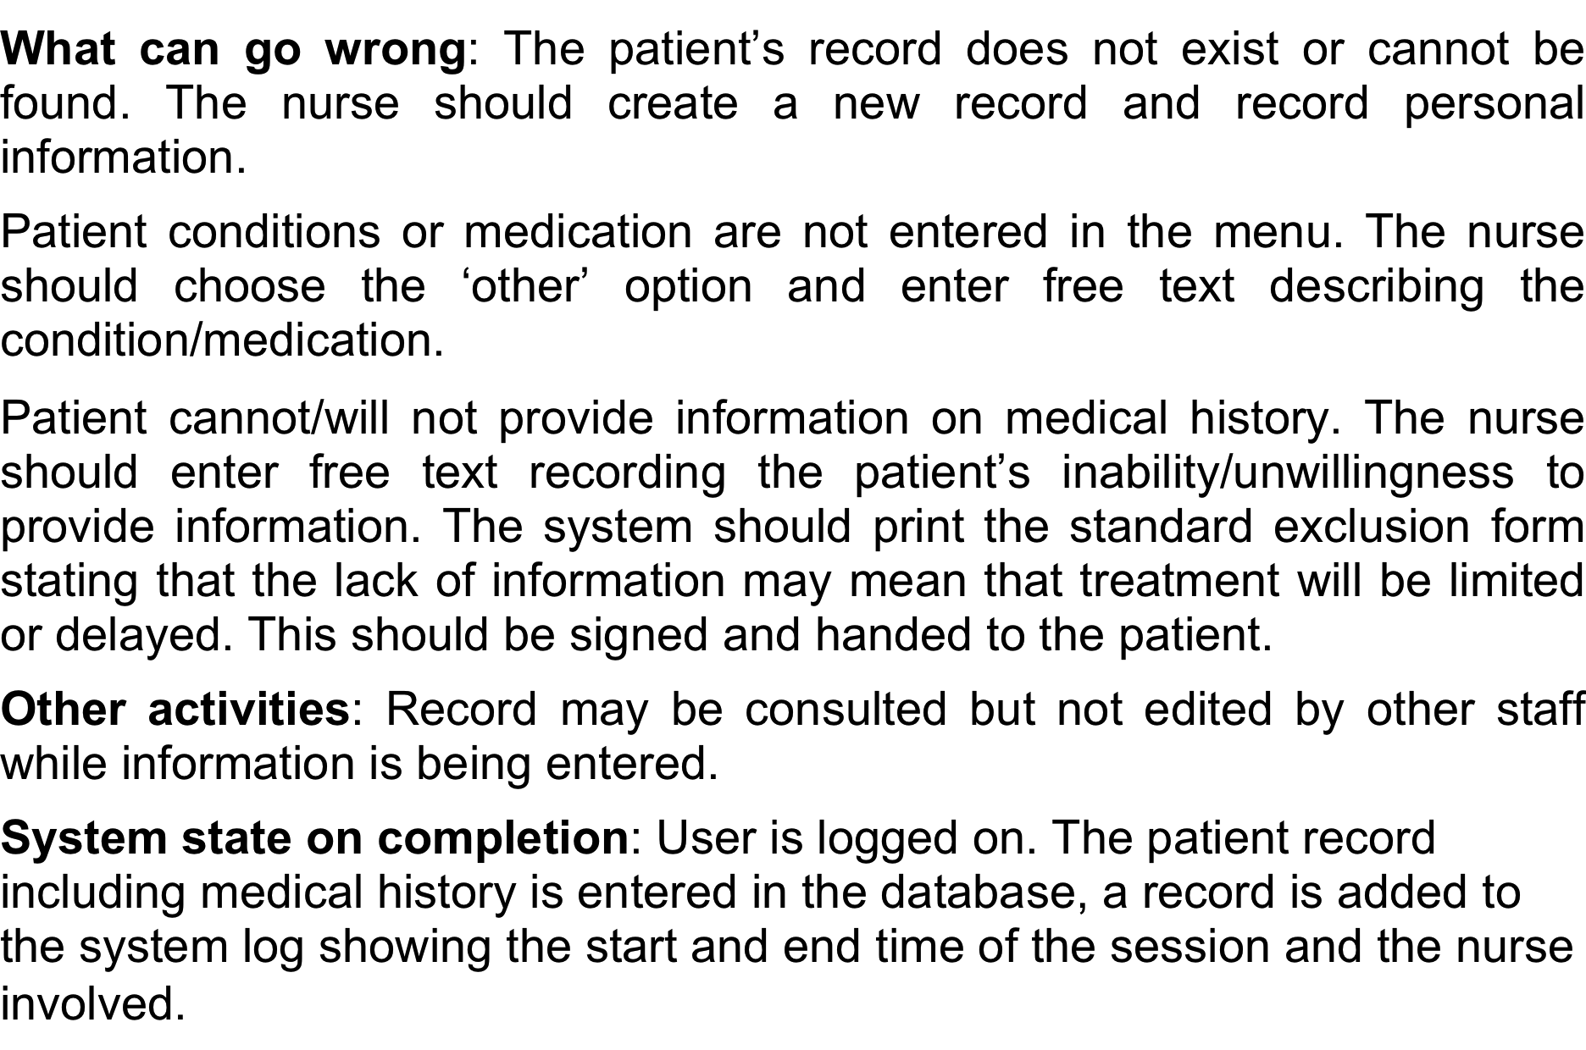
Scenario for collecting medical history in MHC-PMS
Chapter 4 Requirements engineering

Slide 4
Requirements specification
The process of writing down the user and system requirements in a requirements document.
User requirements have to be understandable by end-users and customers who do not have a technical background.
System requirements are more detailed requirements and may include more technical information.
The requirements may be part of a contract for the system development
It is therefore important that these are as complete as possible.
Chapter 4 Requirements engineering

Slide 5
Ways of writing a system requirements specification
Notation | Description
Natural language | The requirements are written using numbered sentences in natural language. Each sentence should express one requirement.
Structured natural language | The requirements are written in natural language on a standard form or template. Each field provides information about an aspect of the requirement.
Design description languages | This approach uses a language like a programming language, but with more abstract features to specify the requirements by defining an operational model of the system. This approach is now rarely used although it can be useful for interface specifications.
Graphical notations | Graphical models, supplemented by text annotations, are used to define the functional requirements for the system; UML use case and sequence diagrams are commonly used.
Mathematical specifications | These notations are based on mathematical concepts such as finite-state machines or sets. Although these unambiguous specifications can reduce the ambiguity in a requirements document, most customers don’t understand a formal specification. They cannot check that it represents what they want and are reluctant to accept it as a system contract
Chapter 4 Requirements engineering

Slide 6
Requirements and design
In principle, requirements should state what the system should do and the design should describe how it does this.
In practice, requirements and design are inseparable
A system architecture may be designed to structure the requirements;
The system may inter-operate with other systems that generate design requirements;
The use of a specific architecture to satisfy non-functional requirements may be a domain requirement.
This may be the consequence of a regulatory requirement.

Slide 7
Natural language specification
Requirements are written as natural language sentences supplemented by diagrams and tables.
Used for writing requirements because it is expressive, intuitive and universal. This means that the requirements can be understood by users and customers.
Chapter 4 Requirements engineering

Slide 8
Guidelines for writing requirements
Invent a standard format and use it for all requirements.
Use language in a consistent way. Use shall for mandatory requirements, should for desirable requirements.
Use text highlighting to identify key parts of the requirement.
Avoid the use of computer jargon.
Include an explanation (rationale) of why a requirement is necessary.

Slide 9
Example requirements for the insulin pump software system
3.2 The system shall measure the blood sugar and deliver insulin, if required, every 10 minutes. (Changes in blood sugar are relatively slow so more frequent measurement is unnecessary; less frequent measurement could lead to unnecessarily high sugar levels.) 3.6 The system shall run a self-test routine every minute with the conditions to be tested and the associated actions defined in Table 1. (A self-test routine can discover hardware and software problems and alert the user to the fact the normal operation may be impossible.)
Chapter 4 Requirements engineering

Slide 10
Structured specifications
An approach to writing requirements where the freedom of the requirements writer is limited and requirements are written in a standard way.
This works well for some types of requirements e.g. requirements for embedded control system but is sometimes too rigid for writing business system requirements.
Chapter 4 Requirements engineering

Slide 11
Form-based specifications
Definition of the function or entity.
Description of inputs and where they come from.
Description of outputs and where they go to.
Information about the information needed for the computation and other entities used.
Description of the action to be taken.
Pre and post conditions (if appropriate).
The side effects (if any) of the function.

Slide 12
A structured specification of a requirement for an insulin pump
Chapter 4 Requirements engineering

Slide 13
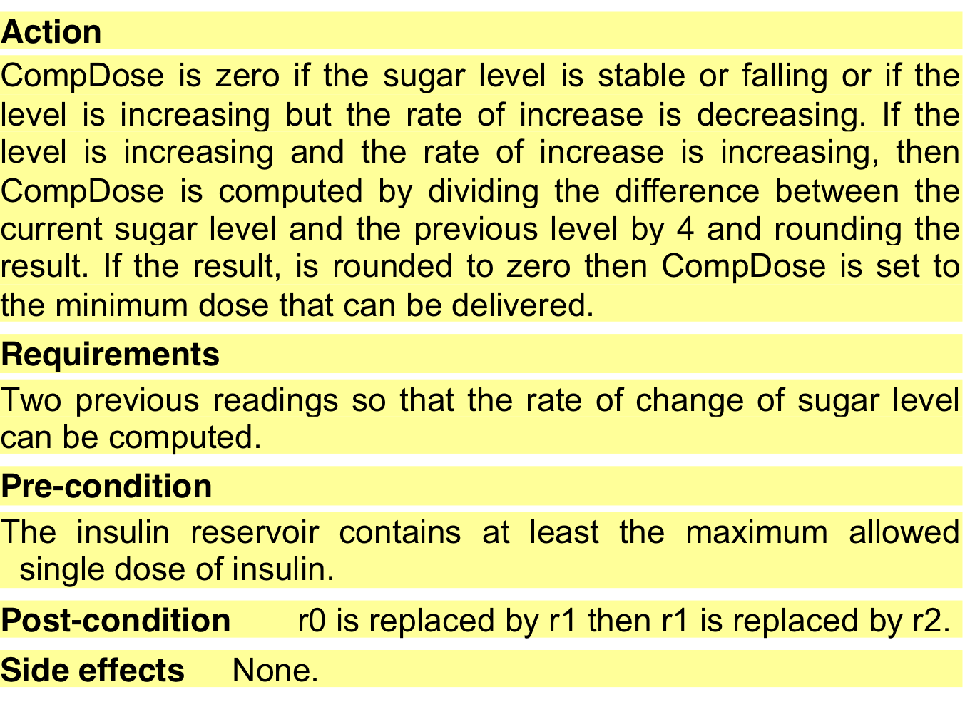
A structured specification of a requirement for an insulin pump
Chapter 4 Requirements engineering

Slide 14
Tabular specification
Used to supplement natural language.
Particularly useful when you have to define a number of possible alternative courses of action.
For example, the insulin pump systems bases its computations on the rate of change of blood sugar level and the tabular specification explains how to calculate the insulin requirement for different scenarios.

Slide 15
Tabular specification of computation for an insulin pump
Condition | Action
Sugar level falling (r2 < r1) | CompDose = 0
Sugar level stable (r2 = r1) | CompDose = 0
Sugar level increasing and rate of increase decreasing ((r2 – r1) < (r1 – r0)) | CompDose = 0
Sugar level increasing and rate of increase stable or increasing ((r2 – r1) ≥ (r1 – r0)) | CompDose = round ((r2 – r1)/4) If rounded result = 0 then CompDose = MinimumDose
Chapter 4 Requirements engineering

Slide 16
Use cases
High-level graphical model supplemented by more detailed tabular description (see Chapter 5).
Use-cases are a scenario based technique in the UML which identify the actors in an interaction and which describe the interaction itself.
A set of use cases should describe all possible interactions with the system.
Sequence diagrams may be used to add detail to use-cases by showing the sequence of event processing in the system.
Chapter 4 Requirements engineering

Slide 17
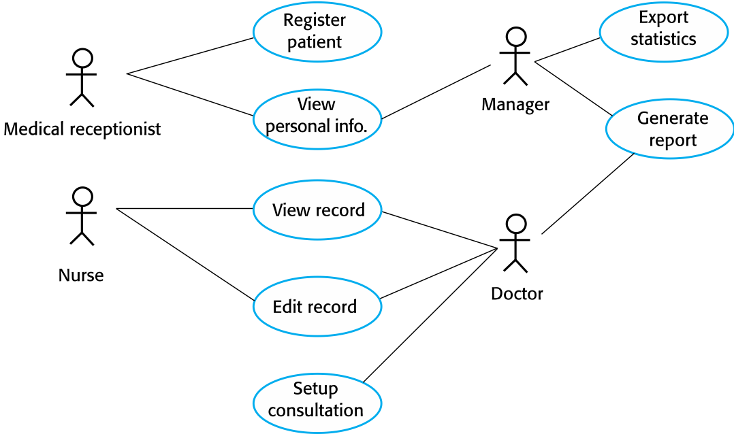
Use cases for the MHC-PMS
Chapter 4 Requirements engineering

Slide 18
The software requirements document
The software requirements document is the official statement of what is required of the system developers.
Should include both a definition of user requirements and a specification of the system requirements.
It is NOT a design document. As far as possible, it should set of WHAT the system should do rather than HOW it should do it.
Chapter 4 Requirements engineering

Slide 19
Agile methods and requirements
Many agile methods argue that producing a requirements document is a waste of time as requirements change so quickly.
The document is therefore always out of date.
Methods such as XP use incremental requirements engineering and express requirements as ‘user stories’ (discussed in Chapter 3).
This is practical for business systems but problematic for systems that require a lot of pre-delivery analysis (e.g. critical systems) or systems developed by several teams.
Chapter 4 Requirements engineering

Slide 20
Users of a requirements document
Chapter 4 Requirements engineering

Slide 21
Requirements document variability
Information in requirements document depends on type of system and the approach to development used.
Systems developed incrementally will, typically, have less detail in the requirements document.
Requirements documents standards have been designed e.g. IEEE standard. These are mostly applicable to the requirements for large systems engineering projects.
Chapter 4 Requirements engineering

Slide 22
The structure of a requirements document
Chapter | Description
Preface | This should define the expected readership of the document and describe its version history, including a rationale for the creation of a new version and a summary of the changes made in each version.
Introduction | This should describe the need for the system. It should briefly describe the system’s functions and explain how it will work with other systems. It should also describe how the system fits into the overall business or strategic objectives of the organization commissioning the software.
Glossary | This should define the technical terms used in the document. You should not make assumptions about the experience or expertise of the reader.
User requirements definition | Here, you describe the services provided for the user. The nonfunctional system requirements should also be described in this section. This description may use natural language, diagrams, or other notations that are understandable to customers. Product and process standards that must be followed should be specified.
System architecture | This chapter should present a high-level overview of the anticipated system architecture, showing the distribution of functions across system modules. Architectural components that are reused should be highlighted.
Chapter 4 Requirements engineering

Slide 23
The structure of a requirements document
Chapter | Description
System requirements specification | This should describe the functional and nonfunctional requirements in more detail. If necessary, further detail may also be added to the nonfunctional requirements. Interfaces to other systems may be defined.
System models | This might include graphical system models showing the relationships between the system components and the system and its environment. Examples of possible models are object models, data-flow models, or semantic data models.
System evolution | This should describe the fundamental assumptions on which the system is based, and any anticipated changes due to hardware evolution, changing user needs, and so on. This section is useful for system designers as it may help them avoid design decisions that would constrain likely future changes to the system.
Appendices | These should provide detailed, specific information that is related to the application being developed; for example, hardware and database descriptions. Hardware requirements define the minimal and optimal configurations for the system. Database requirements define the logical organization of the data used by the system and the relationships between data.
Index | Several indexes to the document may be included. As well as a normal alphabetic index, there may be an index of diagrams, an index of functions, and so on.
Chapter 4 Requirements engineering

Slide 24
Requirements validation
Concerned with demonstrating that the requirements define the system that the customer really wants.
Requirements error costs are high so validation is very important
Fixing a requirements error after delivery may cost up to 100 times the cost of fixing an implementation error.
Chapter 4 Requirements engineering

Slide 25
Requirements checking
Validity. Does the system provide the functions which best support the customer’s needs?
Consistency. Are there any requirements conflicts?
Completeness. Are all functions required by the customer included?
Realism. Can the requirements be implemented given available budget and technology
Verifiability. Can the requirements be checked?
Chapter 4 Requirements engineering

Slide 26
Requirements validation techniques
Requirements reviews
Systematic manual analysis of the requirements.
Prototyping
Using an executable model of the system to check requirements. Covered in Chapter 2.
Test-case generation
Developing tests for requirements to check testability.
Chapter 4 Requirements engineering

Slide 27
Requirements management
Requirements management is the process of managing changing requirements during the requirements engineering process and system development.
New requirements emerge as a system is being developed and after it has gone into use.
You need to keep track of individual requirements and maintain links between dependent requirements so that you can assess the impact of requirements changes. You need to establish a formal process for making change proposals and linking these to system requirements.
Chapter 4 Requirements engineering

Slide 28
Requirements change
The business and technical environment of the system always changes after installation.
New hardware may be introduced, it may be necessary to interface the system with other systems, business priorities may change (with consequent changes in the system support required), and new legislation and regulations may be introduced that the system must necessarily abide by.
The people who pay for a system and the users of that system are rarely the same people.
System customers impose requirements because of organizational and budgetary constraints. These may conflict with end-user requirements and, after delivery, new features may have to be added for user support if the system is to meet its goals.
Chapter 4 Requirements engineering

Slide 29
Requirements change
Large systems usually have a diverse user community, with many users having different requirements and priorities that may be conflicting or contradictory.
The final system requirements are inevitably a compromise between them and, with experience, it is often discovered that the balance of support given to different users has to be changed.
Chapter 4 Requirements engineering

Slide 30
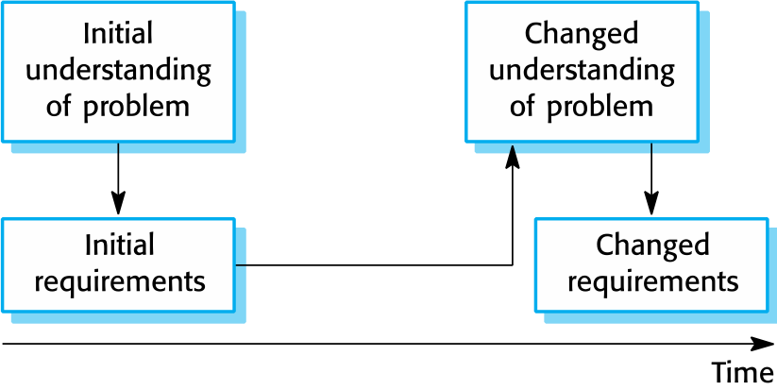
Requirements evolution
Chapter 4 Requirements engineering

Slide 31
Requirements management planning
Establishes the level of requirements management detail that is required.
Requirements management decisions:
Requirements identification Each requirement must be uniquely identified so that it can be cross-referenced with other requirements.
A change management process This is the set of activities that assess the impact and cost of changes. I discuss this process in more detail in the following section.
Traceability policies These policies define the relationships between each requirement and between the requirements and the system design that should be recorded.
Tool support Tools that may be used range from specialist requirements management systems to spreadsheets and simple database systems.
Chapter 4 Requirements engineering

Slide 32
Requirements change management
Deciding if a requirements change should be accepted
Problem analysis and change specification
During this stage, the problem or the change proposal is analyzed to check that it is valid. This analysis is fed back to the change requestor who may respond with a more specific requirements change proposal, or decide to withdraw the request.
Change analysis and costing
The effect of the proposed change is assessed using traceability information and general knowledge of the system requirements. Once this analysis is completed, a decision is made whether or not to proceed with the requirements change.
Change implementation
The requirements document and, where necessary, the system design and implementation, are modified. Ideally, the document should be organized so that changes can be easily implemented.
Chapter 4 Requirements engineering

Slide 33
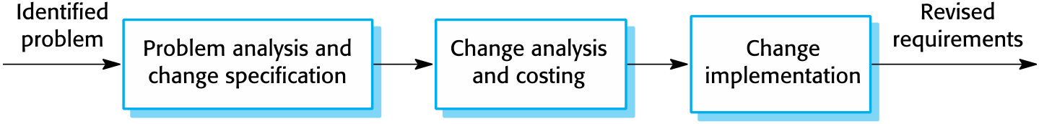
Requirements change management
Chapter 4 Requirements engineering

Slide 34
Key points
Requirements for a software system set out what the system should do and define constraints on its operation and implementation.
Functional requirements are statements of the services that the system must provide or are descriptions of how some computations must be carried out.
Non-functional requirements often constrain the system being developed and the development process being used.
They often relate to the emergent properties of the system and therefore apply to the system as a whole.
Chapter 4 Requirements engineering

Slide 35
Key points
The software requirements document is an agreed statement of the system requirements. It should be organized so that both system customers and software developers can use it.
The requirements engineering process is an iterative process including requirements elicitation, specification and validation.
Requirements elicitation and analysis is an iterative process that can be represented as a spiral of activities – requirements discovery, requirements classification and organization, requirements negotiation and requirements documentation.
Chapter 4 Requirements engineering

Slide 36
Key points
You can use a range of techniques for requirements elicitation including interviews, scenarios, use-cases and ethnography.
Requirements validation is the process of checking the requirements for validity, consistency, completeness, realism and verifiability.
Business, organizational and technical changes inevitably lead to changes to the requirements for a software system. Requirements management is the process of managing and controlling these changes.
Chapter 4 Requirements engineering

